Slide 1
Token Standard Development

Slide 2
Creating ERC-20 contract From Scratch
I can outline the algorithmic steps to create a basic ERC-20 token contract using Solidity, the programming language for Ethereum smart contracts. This is a simplified version for educational purposes and lacks many real-world features. Before deploying any smart contract, ensure you understand the code and security considerations. Here's a high-level algorithm for creating an ERC-20 token:
Contract Setup and Variables:
Define the pragma directive to specify the compiler version.
Define the contract and its name.
Declare state variables for token name, symbol, decimals, total supply, and balances.
Declare mapping to maintain balances

Slide 3
Constructor
constructor(uint256 initialSupply) {
totalSupply = initialSupply * 10 ** uint256(decimals);
balanceOf[msg.sender] = totalSupply;
}
The constructor initializes the contract with an initial supply of tokens, which is multiplied by 10^decimals to account for the token's decimal places.
The total supply is assigned to the contract creator's address.
The balanceOf mapping is updated to show the initial balance of the contract creator

Slide 4
Transfer Function
Implement a function to transfer tokens from the sender's address to another address.
Check for valid addresses and sufficient balance.
Update sender's and recipient's balances.
Emit a Transfer event.

Slide 5
transfer()
function transfer(address to, uint256 value) external returns (bool) {
require(to != address(0), "Invalid address");
require(balanceOf[msg.sender] >= value, "Insufficient balance");
balanceOf[msg.sender] -= value;
balanceOf[to] += value;
emit Transfer(msg.sender, to, value);
return true;
}

Slide 6
Approve Function
Implement a function to allow another address to spend tokens on behalf of the sender.
Store the allowance in the allowances mapping.
Emit an Approval event.

Slide 7
Example:
contract StudentCourses {
// Mapping from student addresses to their enrolled courses
mapping(address => mapping(uint256 => string)) public studentCourses;
function enrollStudent(uint256 _courseId, string memory _courseName) public {
studentCourses[msg.sender][_courseId] = _courseName;
}
function getCourse(uint256 _courseId) public view returns (string memory) {
return studentCourses[msg.sender][_courseId];
}
}

Slide 8
approve()
function approve(address spender, uint256 value) external returns (bool) {
allowance[msg.sender][spender] = value;
emit Approval(msg.sender, spender, value);
return true;
}

Slide 9
Transfer-From Function
Implement a function to allow an approved address to transfer tokens from a sender's address.
Check for valid addresses, sufficient balance, and allowed amount.
Update sender's and recipient's balances and allowances.
Emit a Transfer event.

Slide 10
trnasferFrom()
function transferFrom(address from, address to, uint256 value) external returns (bool) {
require(from != address(0), "Invalid address");
require(to != address(0), "Invalid address");
require(balanceOf[from] >= value, "Insufficient balance");
require(allowance[from][msg.sender] >= value, "Allowance exceeded");
balanceOf[from] -= value;
balanceOf[to] += value;
allowance[from][msg.sender] -= value;
emit Transfer(from, to, value);
return true;
}

Slide 11
approve()
function approve(address spender, uint256 value) external returns (bool) {
allowance[msg.sender][spender] = value;
emit Approval(msg.sender, spender, value);
return true;
}

Slide 12
Transfer-From Function
Implement a function to allow an approved address to transfer tokens from a sender's address.
Check for valid addresses, sufficient balance, and allowed amount.
Update sender's and recipient's balances and allowances.
Emit a Transfer event.

Slide 13
trnasferFrom()
function transferFrom(address from, address to, uint256 value) external returns (bool) {
require(from != address(0), "Invalid address");
require(to != address(0), "Invalid address");
require(balanceOf[from] >= value, "Insufficient balance");
require(allowance[from][msg.sender] >= value, "Allowance exceeded");
balanceOf[from] -= value;
balanceOf[to] += value;
allowance[from][msg.sender] -= value;
emit Transfer(from, to, value);
return true;
}

Slide 14
Mininting function
function mint(address account, uint256 amount) public onlyOwner {
require(account != address(0), "ERC20: Mint to the zero address");
_totalSupply += amount;
_balances[account] += amount;
emit Transfer(address(0), account, amount);
}

Slide 15
Creating an ICO
An Initial Coin Offering (ICO) is a fundraising method used by cryptocurrency and blockchain projects to raise capital for their development and operations. In an ICO, a new cryptocurrency or token is created by the project and offered to the public in exchange for existing cryptocurrencies, typically Bitcoin (BTC) or Ethereum (ETH). Investors participating in the ICO receive the newly created tokens in proportion to their contribution.
The main features of an ICO include:
Token Creation: The project creates a new cryptocurrency or token that will be used within its ecosystem. These tokens often have specific use cases, such as granting access to certain features or services.
Token Sale: The project sets a specific duration for the ICO during which contributors can send their cryptocurrencies (usually BTC or ETH) in exchange for the newly created tokens. The tokens' value is usually tied to the success and potential of the project.

Slide 16
Features
Whitepaper:
Before launching an ICO, the project typically publishes a whitepaper that outlines the project's goals, vision, technical details, token use cases, and information about the ICO itself. This document helps potential investors understand the project and its potential.
Smart Contract:
An ICO is often facilitated through a smart contract deployed on a blockchain platform like Ethereum. The smart contract handles the distribution of tokens to investors and ensures transparency in the process.
Token Distribution:
Once the ICO concludes, the tokens are distributed to the investors' wallets based on the contribution amounts. Investors can hold or trade these tokens on cryptocurrency exchanges.

Slide 17
Features:
Funding:
The funds raised through the ICO are used to support the development, marketing, and operations of the project. Projects often set a funding goal and a "soft cap" (minimum amount needed) to determine the success of the ICO.
Regulation and Compliance:
ICOs have faced regulatory scrutiny in various jurisdictions, and the regulatory environment has evolved over time. Some projects conduct ICOs following regulatory guidelines, while others may avoid jurisdictions with stricter regulations.
Risk and Reward:
Participating in an ICO carries both potential rewards and risks. Investors may gain significant returns if the project succeeds, but they may also face the risk of losing their investment if the project fails or experiences setbacks.

Slide 18
Step by Step Process
Import Required Libraries:
Begin by importing the necessary libraries:
IERC20 from OpenZeppelin for the ERC-20 token interface.- or
Import “./IERC20”;
Contract Initialize
contract ICO {
// Contract state variables and events will go here
}

Slide 19
Declare State Variables:
Declare the following state variables within the contract:
IERC20 public token to represent the ERC-20 token being sold.
uint256 public tokenPrice for the price of one token in wei.
uint256 public tokensSold to keep track of tokens sold.
address[] private contributors to store addresses of contributors
IERC20 public token;
uint256 public tokenPrice;
uint256 public tokensSold;
address[] private contributors;

Slide 20
Create constructor
Write the constructor that takes _tokenAddress and _initialTokenPrice as parameters to initialize the contract:
constructor(address _tokenAddress, uint256 _initialTokenPrice) {
token = IERC20(_tokenAddress);
tokenPrice = _initialTokenPrice;
}

Slide 21
Implementing buyToken() Function
Implement the buyTokens function, which allows participants to buy tokens. It takes _numTokens as the number of tokens to purchase.
function buyTokens(uint256 _numTokens) external payable {
// Function implementation here
}
Inside the function, perform the following steps:
Ensure _numTokens is greater than 0.
Calculate totalPrice by multiplying _numTokens with tokenPrice.
Require that the sent Ether is at least equal to totalPrice.
Transfer _numTokens tokens to the sender.
Increment tokensSold by _numTokens.
Add the sender's address to contributors if not already added.
Emit the TokensPurchased event

Slide 22
// Function to buy tokens
function buyTokens(uint256 _numTokens) external payable {
require(_numTokens > 0, "Number of tokens must be greater than 0");
uint256 totalPrice = _numTokens * tokenPrice;
require(msg.value >= totalPrice, "Insufficient Ether sent");
token.transfer(msg.sender, _numTokens);
tokensSold += _numTokens;
if (!isContributor(msg.sender)) {
contributors.push(msg.sender);
}
emit TokensPurchased(msg.sender, _numTokens, totalPrice);
}

Slide 23
Implement isContributor() function
Implement the isContributor function to check if an address is a contributor.
function isContributor(address _address) public view returns (bool) {
// Function implementation here
}
Inside the function, loop through the contributors array and return true if the given _address is found.

Slide 24
Implementation
// Function to check if an address has contributed
function isContributor(address _address) public view returns (bool) {
for (uint256 i = 0; i < contributors.length; i++) {
if (contributors[i] == _address) {
return true;
}
}
return false;
}

Slide 25
Implement getContributor() function
Implement the getTotalContributors function to return the total number of contributors.
function getTotalContributors() external view returns (uint256) {
// Function implementation here
}
Simply return the length of the contributors array.

Slide 26
Implementation
// Function to get the total number of contributors
function getTotalContributors() external view returns (uint256) {
return contributors.length;
}

Slide 27
Implement withdraw() function
Implement the withdrawEther function to allow the owner to withdraw Ether from the contract.
function withdrawEther() external onlyOwner {
// Function implementation here
}
Transfer the entire balance of the contract to the contract owner.

Slide 28
Implementation
// Function to withdraw Ether from the contract (only by the owner)
function withdrawEther() external onlyOwner {
uint256 balance = address(this).balance;
payable(owner).transfer(balance);
}

Slide 29
Implement updateTokenPrice() fucntion
Implement the updateTokenPrice function to allow the owner to update the token price.
function updateTokenPrice(uint256 _newPrice) external onlyOwner {
// Function implementation here
}
Update the tokenPrice with _newPrice.

Slide 30
Implementation
// Function to update the token price (only by the owner)
function updateTokenPrice(uint256 _newPrice) external onlyOwner {
tokenPrice = _newPrice;
}

Slide 31
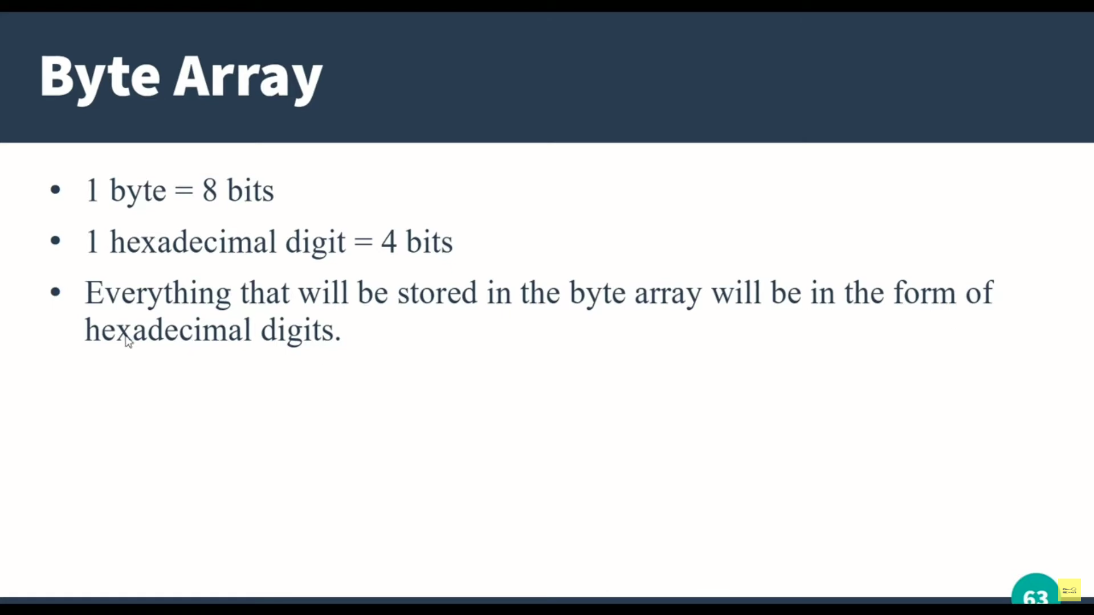

Slide 32
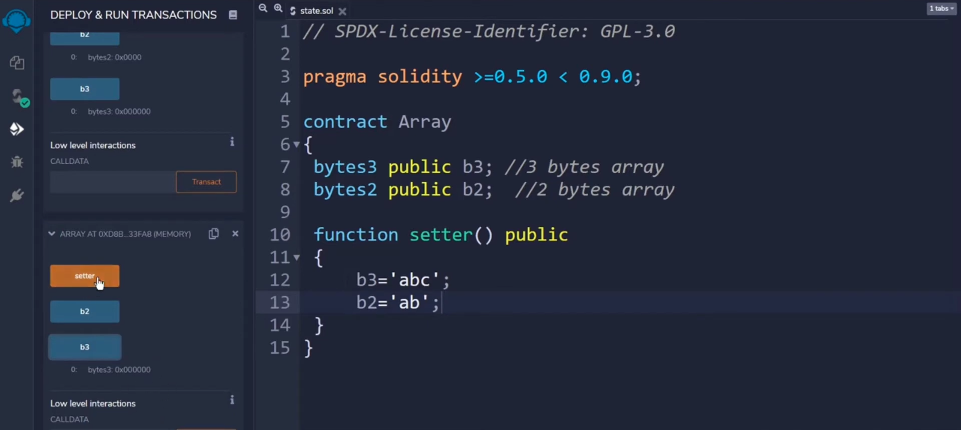

Slide 33
ABI Encode
ABI (Application Binary Interface) encoding and decoding are used to serialize and deserialize data structures in Ethereum smart contracts. It's a way to encode complex data types, such as structs or arrays, into a format that can be efficiently passed between different parts of a smart contract or between contracts themselves. Here's an example of how you can use ABI encoding and decoding in Solidity:

Slide 34
Example:
function encodePerson(string memory name, uint256 age) public pure returns (bytes memory) {
return abi.encode(name, age);
}
function decodePerson(bytes memory encodedData) public pure returns (string memory, uint256) {
(string memory name, uint256 age) = abi.decode(encodedData, (string, uint256));
return (name, age);
}
// SPDX-License-Identifier: MIT
pragma solidity ^0.8.0;
contract ABIExample {
struct Person {
string name;
uint256 age;
}
}

Slide 35
PackedEncoding
Packed encoding in ABI refers to encoding data without adding padding between elements. This can be useful when you want to minimize the size of the encoded data for storage or transmission. Here's an example of how you can use packed ABI encoding in Solidity:

Slide 36
Create an NFT through Openzeppelin
You have to import Libraries into your contract through openzeppelin.
You can also use openzeppeline Wizard for creating NFTs.
https://docs.openzeppelin.com/contracts/4.x/wizard
Click on above link to create your NFTs.

Slide 37
Create a custom NFT Contract.
You have to create a NFT contract where you can buy nft with ether. And also control its totalSupply.
There are following instructions that you have to follow.
Import libraries from openzeppelin that are require.
Declare state variable.
Declare mapping to keep track of balances.
Declare constructor

Slide 38
Create a function that control minting that its is allowed or not
Create a function to set maxSupply
Create a minting function that consist of following steps
Check sufficient balance;
Only 1 nft can be mint on 1 address;
maxSupply greater then Totalsupply;
Minting function is toggled;
Increment caller Address
Increment totalSupply
Assign totalSupply to a tokenID
Call mint function from ERC721 contract

Slide 39
Smart Contract
// SPDX-License-Identifier: MIT
pragma solidity ^0.8.0;
import "@openzeppelin/contracts/token/ERC721/ERC721.sol";
import "@openzeppelin/contracts/access/Ownable.sol";
contract SimpleNFTcontract is ERC721, Ownable {
uint public mintPrice = 0.5 ether;
uint public totalSuplly;
uint public maxSupply;
bool public isMintable;
mapping(address => uint) public mintedWallet;

Slide 40
To be continued
constructor() payable ERC721("ABC", "abc") {
maxSupply = 2;
}
function toggleMint() external {
isMintable = !isMintable;
}
function setSupply(uint _maxSupply) public {
maxSupply = _maxSupply;
}

Slide 41
Exit
function mint(uint mintValue) payable public {
require(isMintable, "Not Mintable");
require(mintedWallet[msg.sender] > 1, "Minted value Exceed");
require(msg.value == mintValue,"Wrong Value");
require(maxSupply>totalSuplly, "sold out");
mintedWallet[msg.sender]++;
totalSuplly++;
uint tokenID = totalSuplly;
_safeMint(msg.sender, tokenID);
}

